Slide 1
Physics of Surfing
OCE2901 – Surf Engineering Analysis

Slide 2


What is Surfing?
Surfing is the balance of energy in a dynamic system
A wave has Kinetic Energy in the form of momentum transfer
It also has Potential Energy as you raise to the top of the wave
A surfer is a master of using the wave’s energy to propel themselves along the wave face

Slide 3
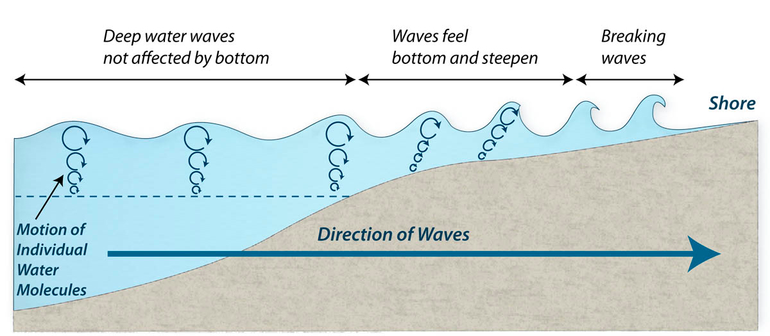
How do Waves Propagate?
Wind blows across the water generating ripples
Overtime, these ripples coalesce into larger waves

Slide 4

Research Topic Quad Chart
Wednesday January 18

Slide 5

Dice Roll Programming Assignment
Friday, January 20

Slide 6

Questions?

